Slide 1
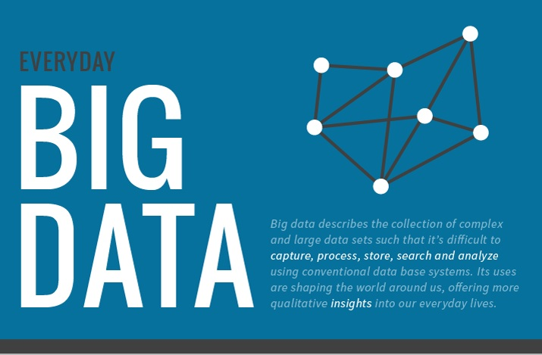

Slide 2
How Much Data Do We Create Every Day?
Data is everywhere !!
Data never sleeps.
We produce 2.5 quintillion bytes of data created each day at our current rate – rough estimate.
90% of the data in the world today has been created in the last two years alone.
This pace is only accelerating with the growth of the Internet of Things (IoT).
Notes:
We live in a world full of data, and it’s expanding at astonishing rates. We may need to unplug and take a break from time to time, but data never sleeps. All around the world, data is being created every minute of every day, from clicks, likes, and shares, to rides, transactions, and streaming content.
Ninety percent of the data in the world today has been created in the last two years alone.
Our current output of data is roughly 2.5 quintillion bytes a day. As the world steadily becomes more connected with an ever-increasing number of electronic devices, that’s only set to grow over the coming years.

Slide 3
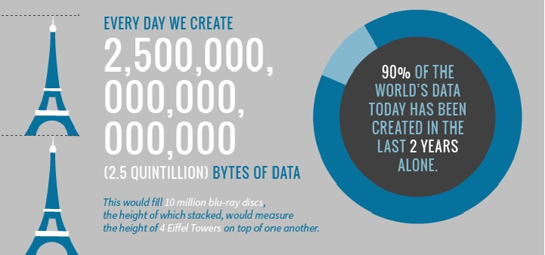
How Much Data Do We Create Every Day?

Slide 4
Social Media
Snapchat users share 527,760 photos
More than 120 professionals join LinkedIn
Users watch 4,146,600 YouTube videos
456,000 tweets are sent on Twitter
Instagram users post 46,740 photos
These are numbers generated every minute of the day !!
Notes:
Our current love affair with social media certainly fuels data creation

Slide 5
Facebook statistics
1.5 billion people are active on Facebook daily.
There are five new Facebook profiles created every second!
More than 300 million photos get uploaded per day.
Every minute there are 510,000 comments posted and 293,000 statuses updated.
Notes:
With 2 billion active users Facebook is still the largest social media platform. Let that sink in a moment—more than a quarter of the world’s 7 billion humans are active on Facebook! Here are some more intriguing Facebook statistics:

Slide 6
Volume of communication
(text to emails sent out every minute)
We send 16 million text messages.
There are 990,000 Tinder swipes.
156 million emails are sent; worldwide it is expected that there will be 9 billion email users by 2019.
15,000 GIFs are sent via Facebook messenger.
Every minute there are 103,447,520 spam emails sent.
There are 154,200 calls on Skype.

Slide 7
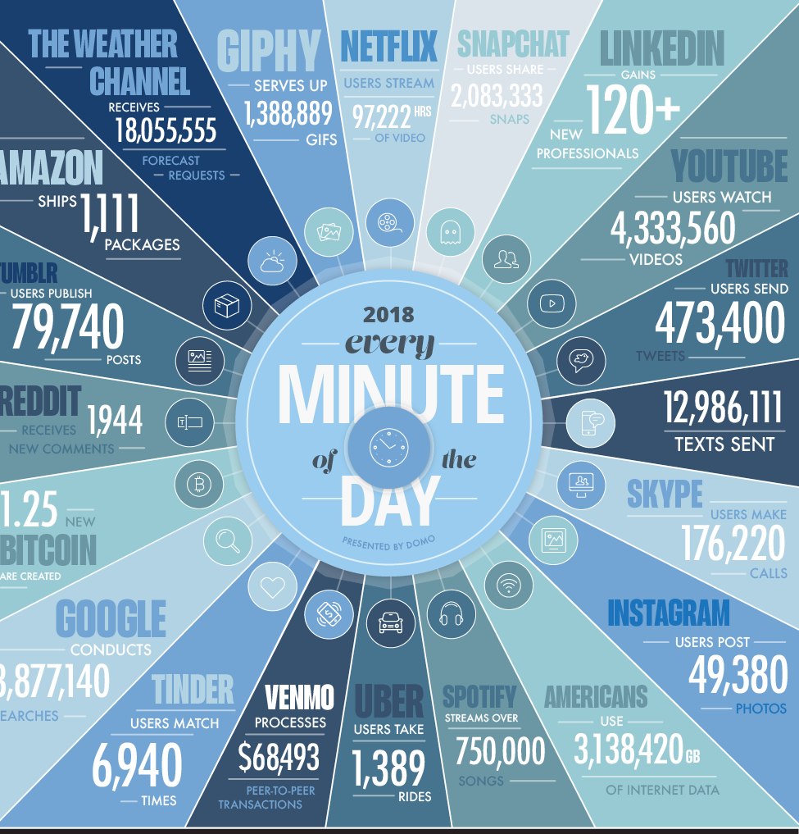

Slide 8
Future Predictions
By the year 2020 (not as far away as it sounds):
1.7 megabytes of new information will be created every second, per person.
Around 1/3 of all data will be processed through the cloud.
Today, less than 0.5% of available data is actually being analyzed.
Notes:
if these Big Data facts didn’t leave you feeling full of opportunities, let this final fact do that for you:
Today, less than 0.5% of available data is actually being analyzed.

Slide 9
Sources of Data
Data is obtained primarily from two sources :
Internal Sources :
Internal data is the information that the business already has on hand, has control of and currently owns, including details contained within the company’s own computer systems and cloud environments.
External Sources:
External data is information that is not currently owned by the company, and can include unstructured, public data as well as information gathered by other organizations.
Notes:
Data can come from multiple sources – db’s, ERP systems, weblogs, chat history, GPS maps etc.
Companies have a wealth of big data under their own roofs.

Slide 10
Types of Data
Structured data
Unstructured data
Semi-structured data

Slide 11
Structured data
“ Structured data is data that has been organized into a formatted repository, typically a database, so that its elements can be made addressable for more effective processing and analysis”.
“ Structured data is data that has a defined repeating pattern. This makes it easier for any program to sort, read and process the data”

Slide 12
Structured Data....
Is organized data in a predefined format.
Is stored in a tabular form.
Is the data that resides in fixed fields within a record/file.
Is formatted data that has entities & their attributes mapped.
Is used to query and report against predetermined data types.
Sources : Relational Db’s, Legacy Db’s, MultiDimensional Db’s, Flat files in the form of records.

Slide 13
An 'Employee' Table In A Database Is An Example Of Structured Data
Employee_ID | Employee_Name | Gender | Department | Salary_In_lacs
2365 | Rajesh Kulkarni | Male | Finance | 650000
7465 | Pratibha Joshi | Female | Admin | 650000
7500 | Shushil Roy | Male | Admin | 500000

Slide 14
Unstructured data
Might/Might not have a repeating pattern.
Typically consists of meta data.
Comprises inconsistent data – data obtained from files, social media websites, satellites etc.
Consists of data in different formats – emails, text, video, images etc
Sources : Text both internal and external to an organization, Social media, Mobile data.

Slide 15
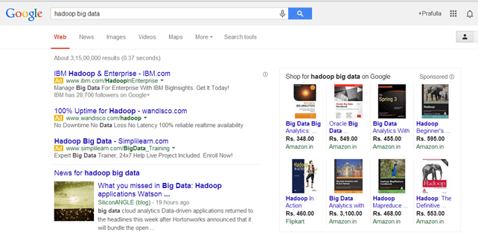
Example Of Un-structured Data
Output returned by 'Google Search'

Slide 16
SEMI-structured data
Self-describing structure.
Is a form of structured data that contains tags or mark-up elements.
Do not follow the proper structure of data models as in relational db’s.
Data is stored in rows and columns inconsistently.
Sources : Web data(cookies), JSON data etc.

Slide 17
Example Of Semi-structured Data
Personal data stored in a XML file-
<rec><name>Prashant Rao</name><sex>Male</sex><age>35</age></rec> <rec><name>Seema R.</name><sex>Female</sex><age>41</age></rec> <rec><name>Satish Mane</name><sex>Male</sex><age>29</age></rec> <rec><name>Subrato Roy</name><sex>Male</sex><age>26</age></rec> <rec><name>Jeremiah J.</name><sex>Male</sex><age>35</age></rec>

Slide 18
CHARACERISTICS OF BIG DATA
#1: Volume
#2: Velocity
#3: Variety
#4:Veracity
#5: Variability
#6: Validity
#7: Vulnerability
#8: Volatility
#9: Visualization
#10: Value

Slide 19
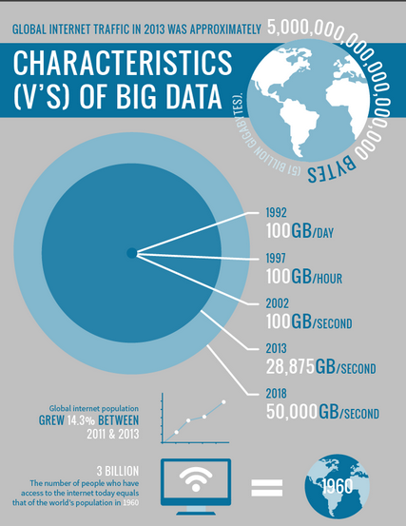
VOLUME

Slide 20
In total, 2.7 Zettabytes of data exists in our digital universe. (A zettabyte is equal to 1,024 exabytes)
149, 513 emails are sent every minute.
3.3 million (undoubtedly extremely insightful) Facebook posts are created every minute.
3.8 Google million searches are performed each minute.
Each minute, 65,972 Instagram photos are uploaded.
448,800 Tweets are constructed. How often? Every minute.
500 hours of YouTube videos are uploaded every minute.

Slide 21
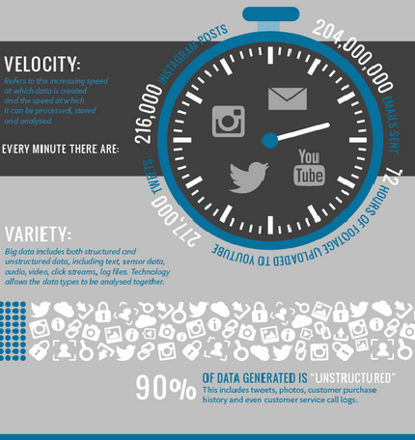
VELOCITY .
Velocity refers to the speed at which new data is being generated, produced, created, or refreshed.
Facebook claims 600 terabytes of incoming data per day.
Google alone processes on average more than "40,000 search queries every second," which roughly translates to more than 3.5 billion searches per day

Slide 22
Variety.
Variety refers to heterogeneous sources and the nature of data- both structured and unstructured.
Most big data seems to be unstructured, but besides audio, image, video files, social media updates, and other text formats there are also log files, click data, machine and sensor data, etc.
Notes:
Variety refers to heterogeneous sources and the nature of data, both structured and unstructured. During earlier days, spreadsheets and databases were the only sources of data considered by most of the applications. Now days, data in the form of emails, photos, videos, monitoring devices, PDFs, audio, etc. is also being considered in the analysis applications. This variety of unstructured data poses certain issues for storage, mining and analysing data.

Slide 23
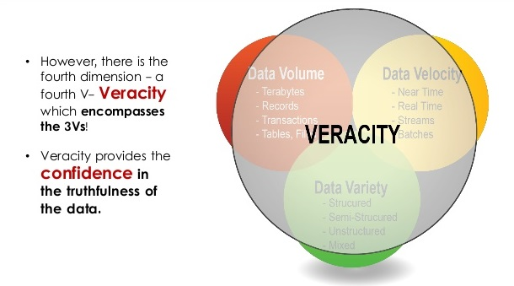
Veracity
Notes:
#5:
This is one of the unfortunate characteristics of big data. As any or all of the above properties increase, the veracity (confidence or trust in the data) drops. This is similar to, but not the same as, validity or volatility (see below). Veracity refers more to the provenance or reliability of the data source, its context, and how meaningful it is to the analysis based on it.
For example, consider a data set of statistics on what people purchase at restaurants and these items' prices over the past five years. You might ask: Who created the source? What methodology did they follow in collecting the data? Were only certain cuisines or certain types of restaurants included? Did the data creators summarize the information? Has the information been edited or modified by anyone else?
Answers to these questions are necessary to determine the veracity of this information. Knowledge of the data's veracity in turn helps us better understand the risks associated with analysis and business decisions based on this particular data set.

Slide 24
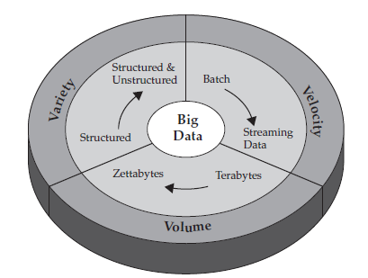
CHARACERISTICS OF BIG DATA

Slide 25
Review.....
Companies have a wealth of big data under their own roofs.
Internal sources – internal data - reflect those data that are under the control of the business.
External sources - external data -any data generated outside the wall of the business.
Structured data - organized data in a predefined format
Semi-structured data – self describing nature
Unstructured data - not been organized into a format –
inconsistent data
Notes:
the difference between structured data, unstructured data and semi-structured data: Unstructured data has not been organized into a format that makes it easier to access and process. In reality, very little data is completely unstructured. Even things that are often considered unstructured data, such as documents and images, are structured to some extent. Structured data is basically the opposite of unstructured: It has been reformatted and its elements organized into a data structure so that elements can be addressed, organized and accessed in various combinations to make better use of the information. Semi-structured data lies somewhere between the two. It is not organized in a complex manner that makes sophisticated access and analysis possible; however, it may have information associated with it, such as metadata tagging, that allows elements contained to be addressed.

Slide 26
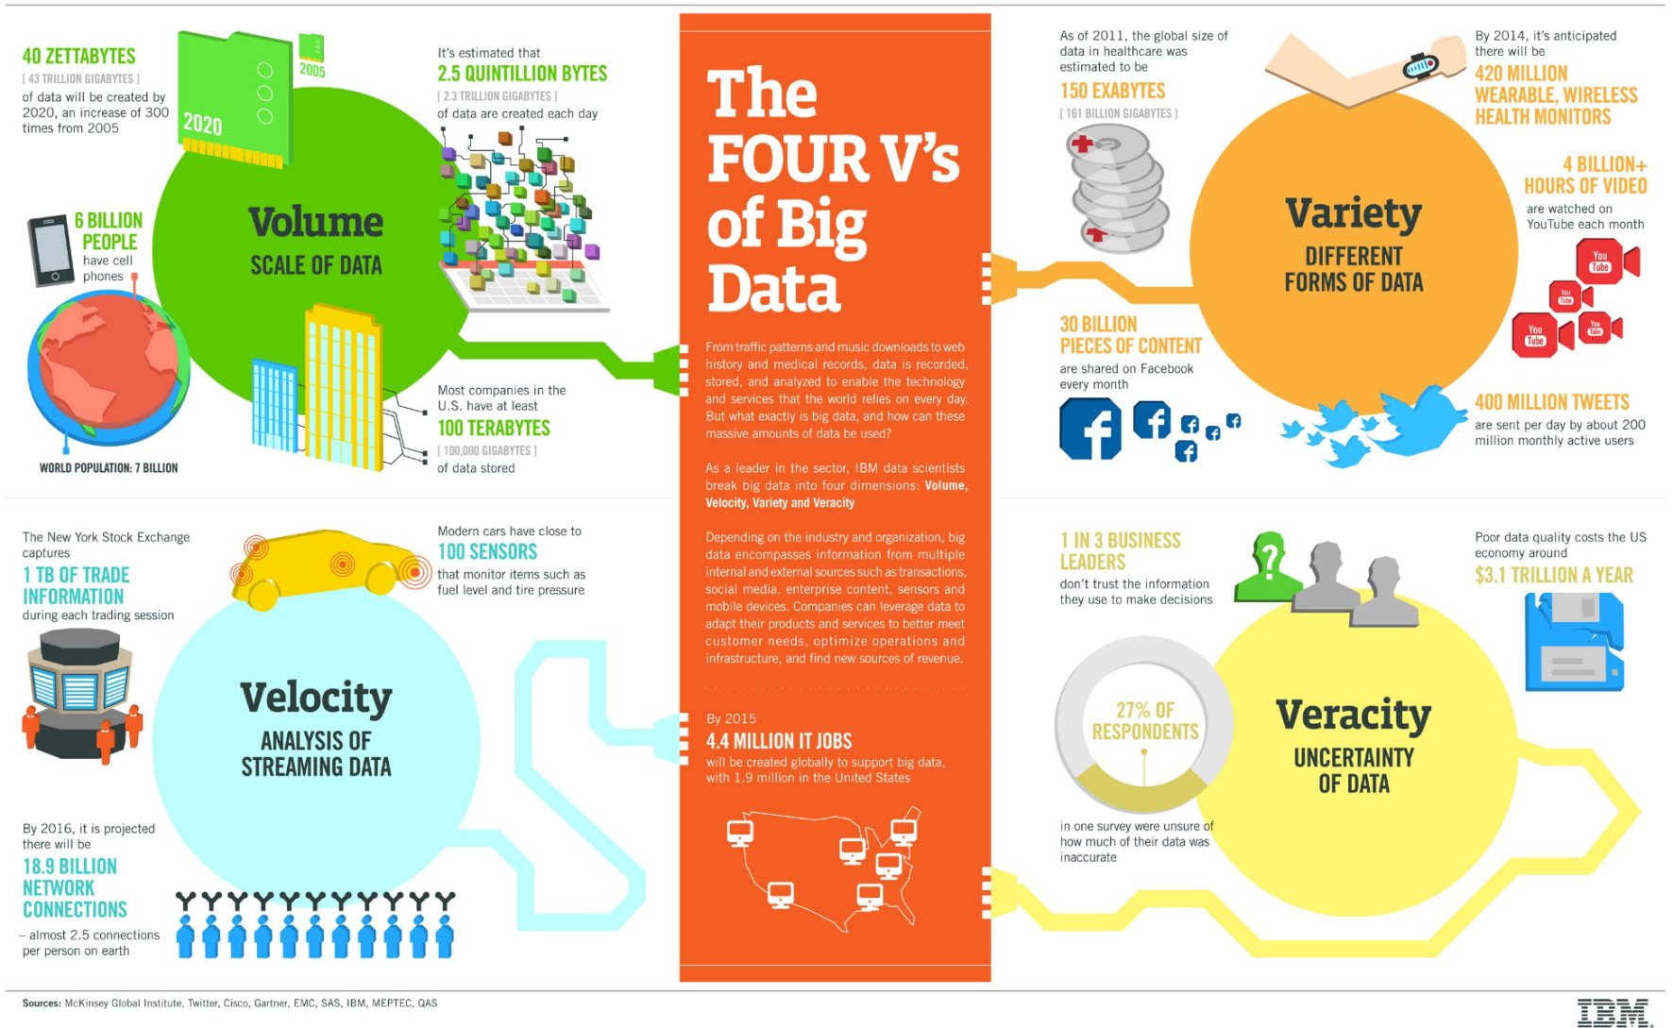

Slide 27
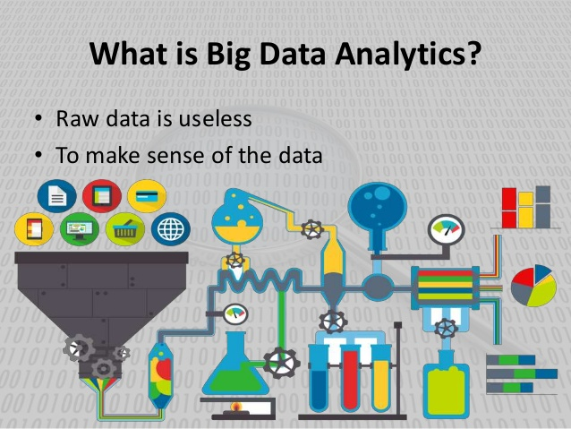
Notes:
Companies have a wealth of big data under their own roofs

Slide 28
Big Data analytics (BDA)
What ?
“BDA is the process of examining large and varied data sets (big data) to uncover hidden patterns, unknown correlations, market trends, customer preferences and other useful information that can help organizations make more-informed business decisions.”
Why ?
Companies implement BDA because they want to make more informed business decisions.

Slide 29
IS DATA ANALYTICS ANYTHING NEW ?
Even in the 1950’s - businesses were using basic analytics to uncover insights and trends.
essentially numbers in a spreadsheet that were manually examined
Benefits that big data analytics brings to the table- speed and efficiency.
Few years ago -gathered information - run analytics -unearthed information - used for future decisions.
Today - business can identify insights for immediate decisions. The ability to work faster – and stay agile – gives organizations a competitive edge they didn’t have before.
Notes:
But even in the 1950s, decades before anyone uttered the term “big data,” businesses were using basic analytics (essentially numbers in a spreadsheet that were manually examined) to uncover insights and trends.
The new benefits that big data analytics brings to the table, however, are speed and efficiency. Whereas a few years ago a business would have gathered information, run analytics and unearthed information that could be used for future decisions, today that business can identify insights for immediate decisions. The ability to work faster – and stay agile – gives organizations a competitive edge they didn’t have before.

Slide 30
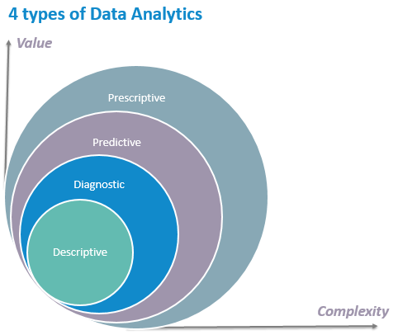
TYPES OF BDA
Descriptive analytics: What happened?
Diagnostic analytics: Why did it happen?
Predictive analytics: What could happen in the future?
Prescriptive analytics: How should we respond to those potential future events?
Notes:
descriptive analytics are more about summarizing and reporting data - allows you to condense big data into smaller, more useful bits of information or a summary of what happened. This type of data analytics is geared towards what is currently happening or what has already happened. A sample data set extracted through descriptive analytics include “top 10 customer service representatives in terms of processed requests for the month of July in Asia.” Businesses can use descriptive analytics, especially those that are just initiating analytics of various data produced internally.
Descriptive analytics juggles raw data from multiple data sources to give valuable insights into the past. However, these findings simply signal that something is wrong or right, without explaining why. For this reason, highly data-driven companies do not content themselves with descriptive analytics only, and prefer combining it with other types of data analytics.
For example, one company discovered that they have spent about $10 million per year on different sales training programs. The outcome of the descriptive analytics was a mere summary of the expenditures, but still, it was useful because they learned an important data about their spending on sales training
For instance, a healthcare provider will learn how many patients were hospitalized last month; a retailer – the average weekly sales volume; a manufacturer – a rate of the products returned for a past month, etc.
Diagnostic analytics - This is the next step in complexity in data analytics is descriptive analytics. On the assessment of the descriptive data, diagnostic analytical tools will empower an analyst to drill down and in so doing isolate the root-cause of a problem
are used for discovery or to determine why something happened. In general, these analytics are looking on the processes and causes, instead of the result.
Take note that descriptive analytics cannot provide an answer to important questions such as “How can we avoid this problem” or “How can we duplicate this solution?” These are covered by diagnostic analytics.
Companies go for diagnostic analytics, as it gives a deep insight into a particular problem.
Let’s take another look at the examples from different industries: a healthcare provider compares patients’ response to a promotional campaign in different regions; a retailer drills the sales down to subcategories.
Predictive analytics
Predictive analytics tells what is likely to happen. It uses the findings of descriptive and diagnostic analytics to detect tendencies, clusters and exceptions, and to predict future trends, which makes it a valuable tool for forecasting. Despite numerous advantages that predictive analytics brings, it is essential to understand that forecasting is just an estimate, the accuracy of which highly depends on data quality and stability of the situation, so it requires a careful treatment and continuous optimization.
Thanks to predictive analytics and the proactive approach it enables, a telecom company, for instance, can identify the subscribers who are most likely to reduce their spend, and trigger targeted marketing activities to remediate;
Prescriptive analytics
The purpose of prescriptive analytics is to literally prescribe what action to take to eliminate a future problem or take full advantage of a promising trend. An example of prescriptive analytics from our project portfolio: a multinational company was able to identify opportunities for repeat purchases based on customer analytics and sales history.
Besides, prescriptive analytics uses sophisticated tools and technologies, like machine learning, business rules and algorithms, which makes it sophisticated to implement and manage. That is why, before deciding to adopt prescriptive analytics, a company should compare required efforts vs. an expected added value.

Slide 31
Descriptive analytics
Serves as base for Advanced analytics
It answers the question what happened in the business
Analyses database to provide information on the trends of past or current business event that can help manager planners leaders to develop a road map for future action
Performs in depth analysis of data to reveal details such as frequency of events, operation costs and underlying reason for failure
Helps in identifying the root cause of the problem

Slide 32
Diagnostic analytics:
takes descriptive data a step further and provides deeper analysis to answer the question: Why did this happen? Often, diagnostic analysis is referred to as root cause analysis.
This includes using processes such as data discovery , data mining, and drill down and drill through.
diagnostic analytics would explore the data and make correlations.

Slide 33
Predictive analytics
Is about and understanding predicting the future and answers the question What could happen
By using statically models and different forecast techniques
It predicts the near future probabilities and trends and helps in analysis
To analyze future predictive analytics use statistics,data mining technique and machine learning

Slide 34
Prescriptive analytics
takes predictive data to the next level.
Now that you have an idea of what will likely happen in the future, what should you do?
It suggests various courses of action and outlines what the potential implications would be for each.
Answers what should we do on the basis of complex data obtained from descriptive and predictive analyses
Determine the finest substitute to minimize or maximize some equitable finanace,marketing and many other areas
For example if we have to find the best way of shipping goods from a factry to a destination to minimize costs we will use prescriptive analytics.

Slide 35
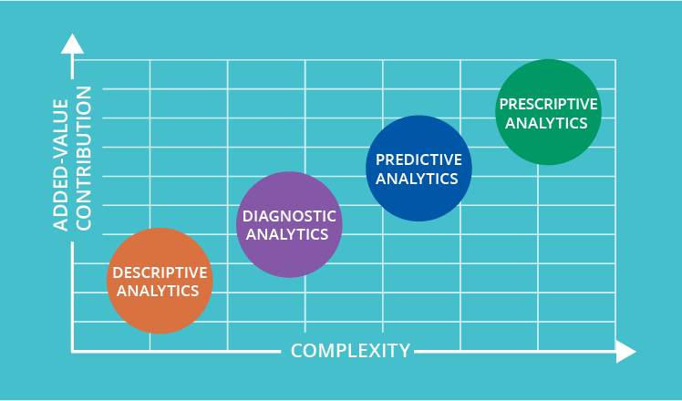
4 types of data analytics to improve decision-making
Notes:
Back in the 17th century, John Dryden wrote, “He who would search for pearls must dive below.” Despite the author did not have advanced data analytics in mind, the quote perfectly describes its essence. Let’s find out how deep one should go into data in search of a much-needed and fact-based insight.
There are 4 types of analytics. Here, we start with the simplest one and go down to more sophisticated. As it happens, the more complex an analysis is, the more value it brings.

Slide 36
Summary
Both descriptive analytics and diagnostic analytics look to the past to explain what happened and why it happened.
Predictive analytics and prescriptive analytics use historical data to forecast what will happen in the future and what actions you can take to affect those outcomes.
Forward-thinking organizations use a variety of analytics together to make smart decisions that help your business

Slide 37
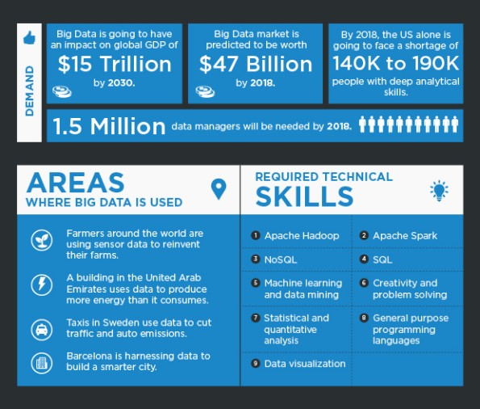
CAREERS IN BIG DATA
Notes:
Big Data is no longer a buzzword for our future capabilities, but is already being used by businesses in a range of industries. From data driven strategies to decision making, the true worth of Big Data has been realized, and has led to opening up of amazing career choices.

Slide 38
TOP BIG DATA PROFILES
DATA SCIENTIST
DATA ENGINEER
BIG DATA ENGINEER
BIG DATA DEVELOPER
BIG DATA ADMINISTRATOR

Slide 39
skills essential FOR a Big Data job
Apache Hadoop.
Apache Spark.
NoSQL.
Machine learning and Data Mining.
Statistical and Quantitative Analysis.
SQL.
Data Visualization.
General Purpose Programming language.
Big Data
=
Programming skills +Data Structure & Algorithms+ Analytical skills + Database Skills + Mathematics + Machine Learning + NLP +OS + Cryptography + Parallel Programming.

Slide 40
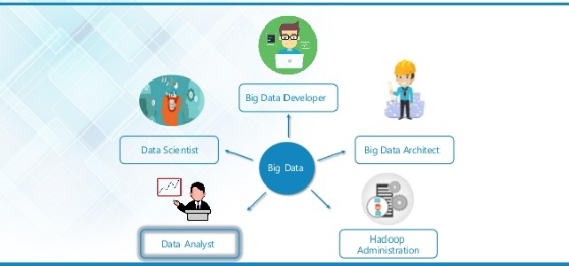
ROLE OF DIFFERENT JOB TITLES

Slide 41
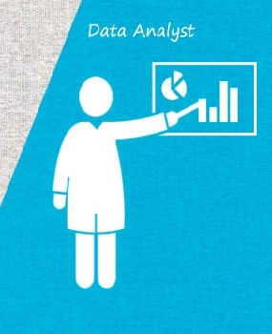
1) BIG DATA ANALYST
A well trained professional who is able to :
Collect data from different sources
Organize it in a suitable format
Analyze the data to generate desired results

Slide 42

2) BIG DATA SCIENTIST
are big data wranglers. They:
take an enormous mass of messy data points (unstructured & structured)
clean, massage and organize them (math, statistics and programming )
to uncover hidden solutions to business challenges (analytic power)
Notes:
A thought leader can :
Collect & analyze data from various angles
Determine what it indicates &
Recommend ways to apply the data.
and use their formidable skills in math, statistics and programming to clean, massage and organize them.
Then they apply all their analytic powers – industry knowledge, contextual understanding, skepticism of existing assumptions –

Slide 43

3) BIG DATA DEVELOPER
A programmer who can design, create, manage & administer :
Large datasets
Custom tools &
Scripts
to achieve business goals

Slide 44

4) BIG DATA ADMINISTRATOR
An admin who is responsible for:
System Upgrades
Mgmt of the data warehouse
Allocation of work load
Storage

Slide 45

5) BIG DATA ENGINEER
A Professional who can:
Design & develop applications using various frameworks and tools

Slide 46
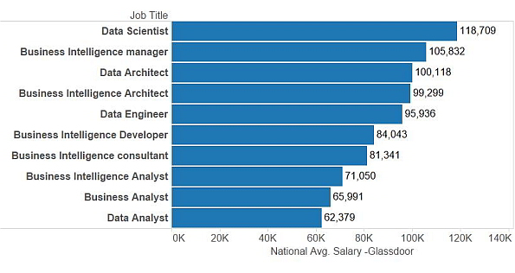
BIG DATA....BIG BUCKS !!

Slide 47
FUTURE OF BIG DATA
Allow the storage and use of transactional data in digital form
Provide more specific information
Refine analytics that can improve decision making
Classify customers for providing customized products and services based on buying patterns

Slide 48
Data Science vs. Big Data vs. Data Analytics

